Slide 1

Adult Education
Board Presentation
February 24, 2021
SEE THE IMPACT

Slide 2


ADULT EDUCATION
Who We Are
Stephanie Ross, Senior Director
Linda Fehoko, Director
Angelica Deleon, Program Manager
Bill Medina, Program Manager
May O’Brien, Program Manager
Denise Johnson, Program Manager
Brigett Bentley, Budget & Compliance Coordinator
Sanjuanita Vela, Secretary
About Us:
Adult Education is a state and federally funded literacy program that consists of English Language, math, reading, writing and workforce training to help students acquire the skills needed to earn a high school equivalency diploma, enter college or to succeed in careers.
SEE THE IMPACT

Slide 3

ADULT EDUCATION
What We Do
We exist to be an innovative leader of Literacy and Workforce Development in partnership with community- based organizations, school districts and industry.
To be the catalyst for life-long learning that will result in creating opportunities that lead to financial independence.

Slide 4

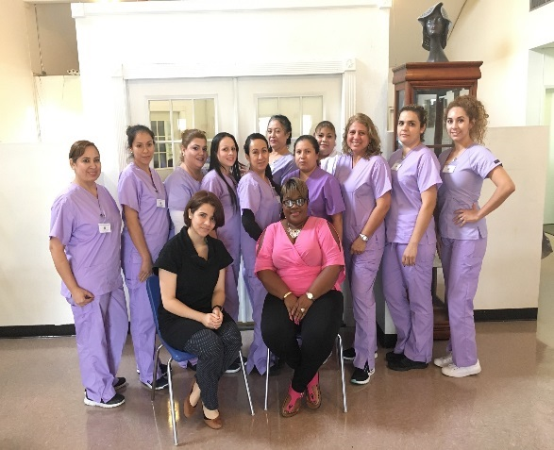
ADULT EDUCATION
Services Provided
Basic Literacy
  English Literacy
  High School Equivalency Prep
Workforce Certification Training
  Certified Nursing Assistant
  Customer Service Marketing Representative
  Medical Assistant Prep
  Heating Ventilation and Air Conditioning
  Business Office Technology
  Phlebotomy
Workforce Literacy
  Work place safety
  Communication and Employability

Slide 5

ADULT EDUCATION
Data Highlights 2019-2020
S
Students By District
Students By Program
Alief ISD | 654
Channelview ISD | 60
CyFair ISD | 295
Deer Park ISD | 123
Galena Park ISD | 140
Goose Creek ISD | 167
Houston ISD | 1228
Katy ISD | 473
Klein ISD | 250
Pasadena ISD | 2394
Spring ISD | 325
Spring Branch ISD | 529
ESL/HSE | 5452
Civics | 417
Workforce | 398
Employer Services | 250
EL Workforce | 121
Total students served:
6638
SEE THE IMPACT

Slide 6

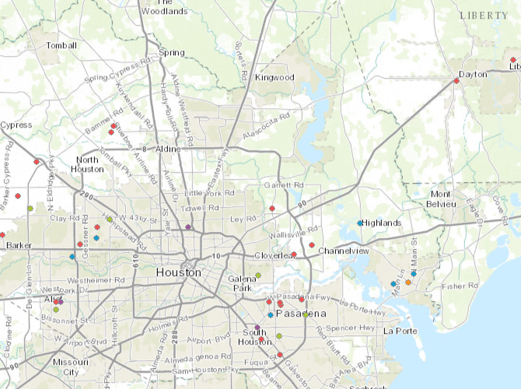
ADULT EDUCATION
Key Highlights
36 Sites – Harris and Liberty Counties
12 ISDs
11 Faith-Based Organizations
4 Non-profit agencies
3 Educational Institutions
5 Businesses

Slide 7













ADULT EDUCATION
Partnerships
City of Houston
Capital Idea Houston
EdOppSolutions
EdVantage
Florida Career College
Houston Methodist
Houston Training & Education Center
Marek Brothers
Pioneer School of Health
Rich’s Products Corp
SEIU Tx
S&B Engineers and Construction
Workforce Solutions

Slide 8
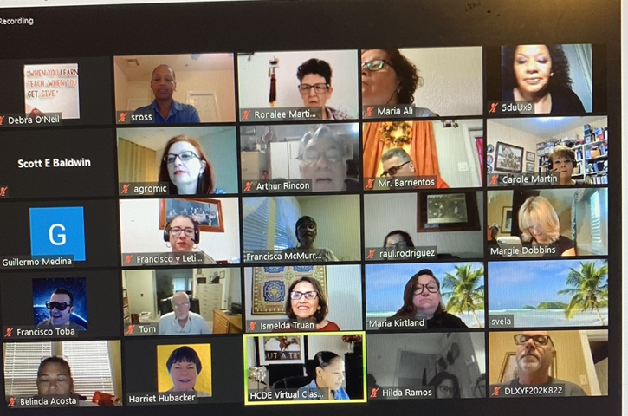
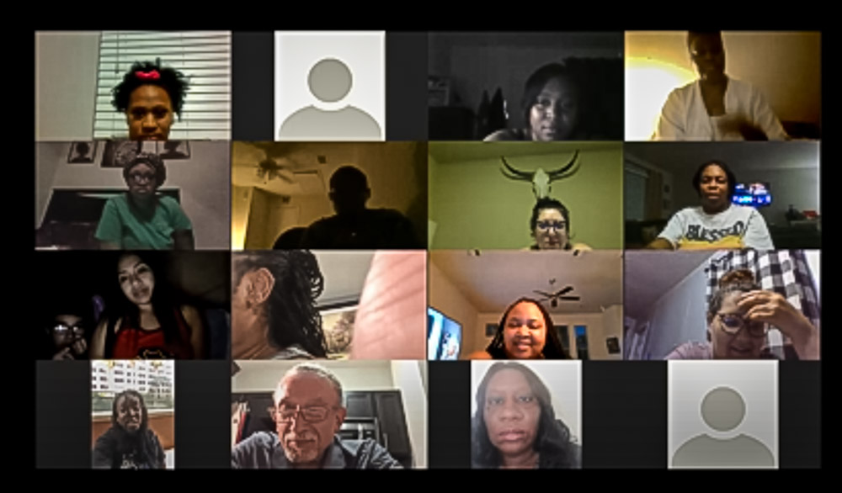
ADULT EDUCATION
Key Highlights
Transitioned to 100% virtual learning
100% full automation
6,000 hours of professional development
Hosted 10 enrichment workshops
(Teacher’s Excellence Corner)
107 earned HS equivalency certificates
Workforce Solutions Collaboration

Slide 9
ADULT EDUCATION
Opportunities for Growth
Career Pathways Programs
Hybrid Learning Platforms
Increase in automation
Micro media eLearning
Shift to measurable skills gains performance•

Slide 10

ADULT EDUCATION
SEE THE IMPACT
Questions?

